Slide 1







F
I
N
A
L
Project
Characterization techniques applied to the thesis: Evaluation of triborheological systems with medical applications
Laura Catalina Duque Ossa – A01747663

Slide 2
FINAL
Agenda
Project
01
Introduction
General description of the thesis and the importance of characterization techniques to evaluate results.
02
Characterization Techniques
Explanation of 6 techniques that allows to evaluate different characteristics inside the research.
03
Summary
Positive effect of the techniques on the research.
04
Q/A
Questions and answers from professors and students.

Slide 3
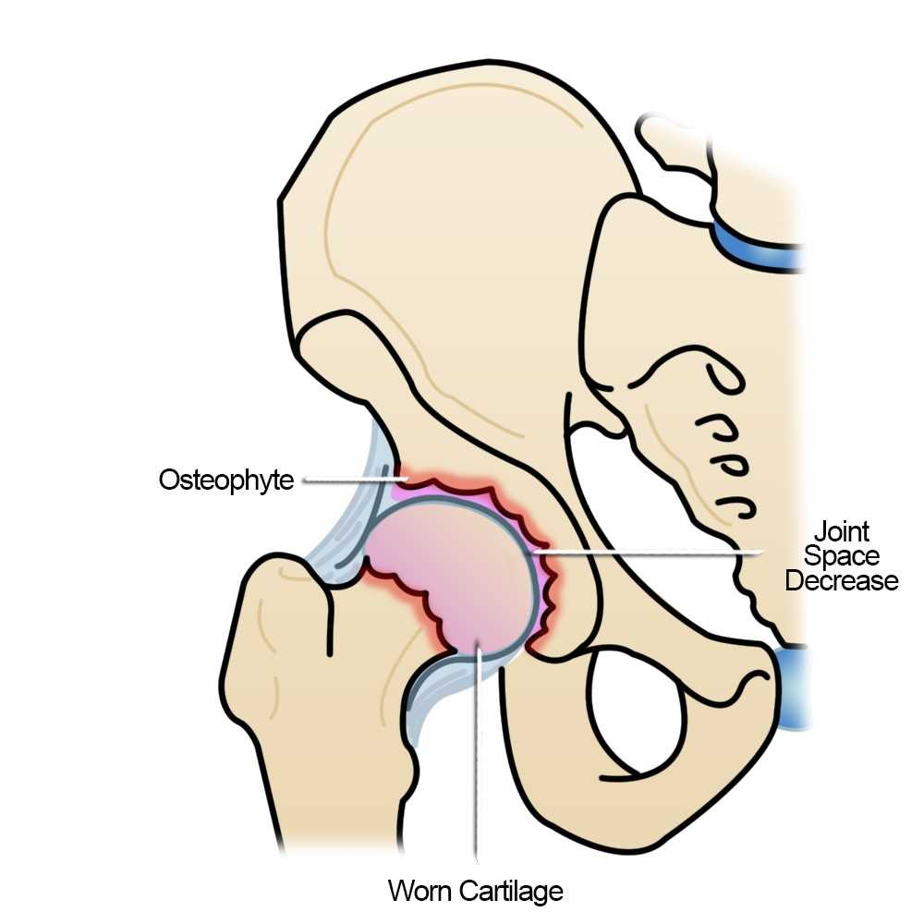
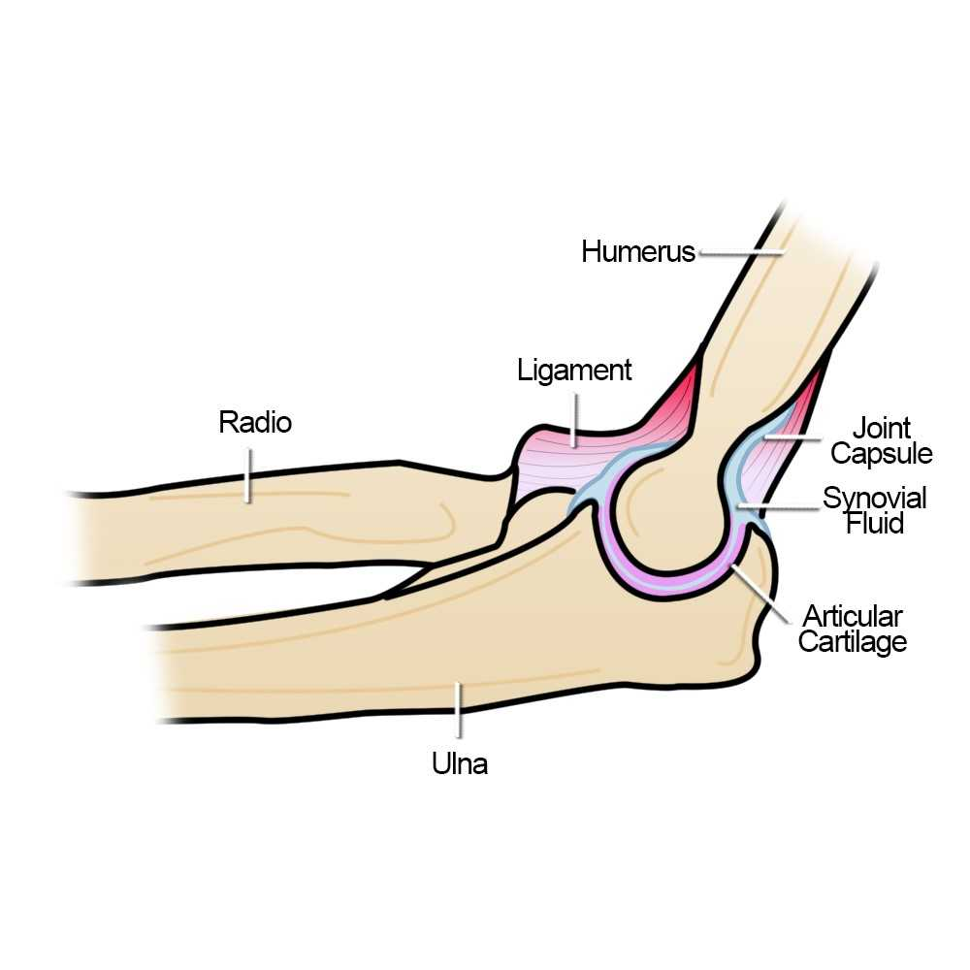
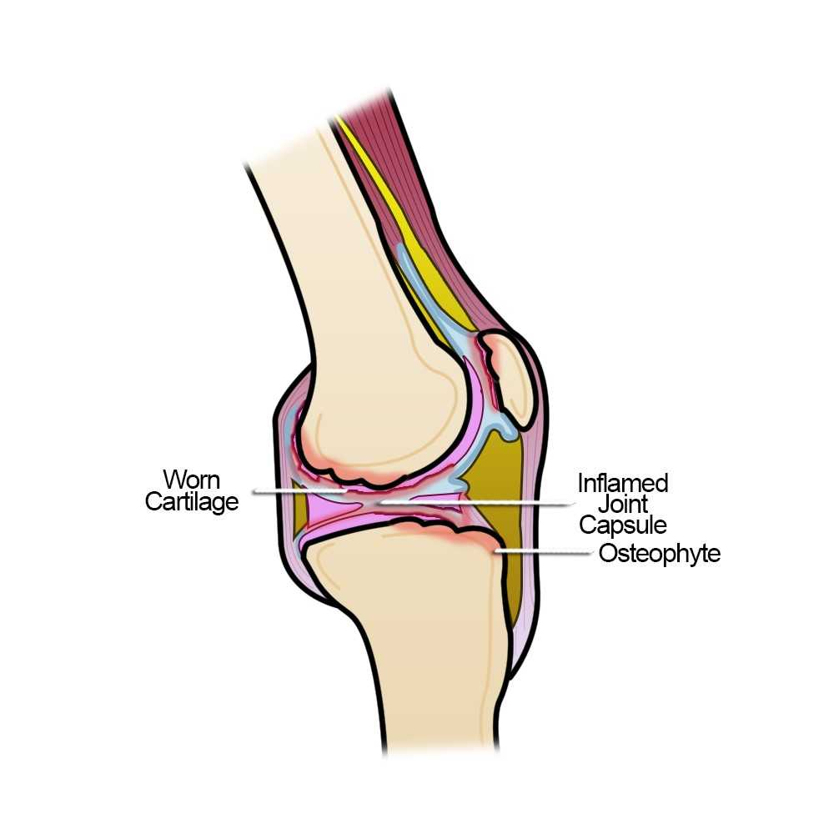
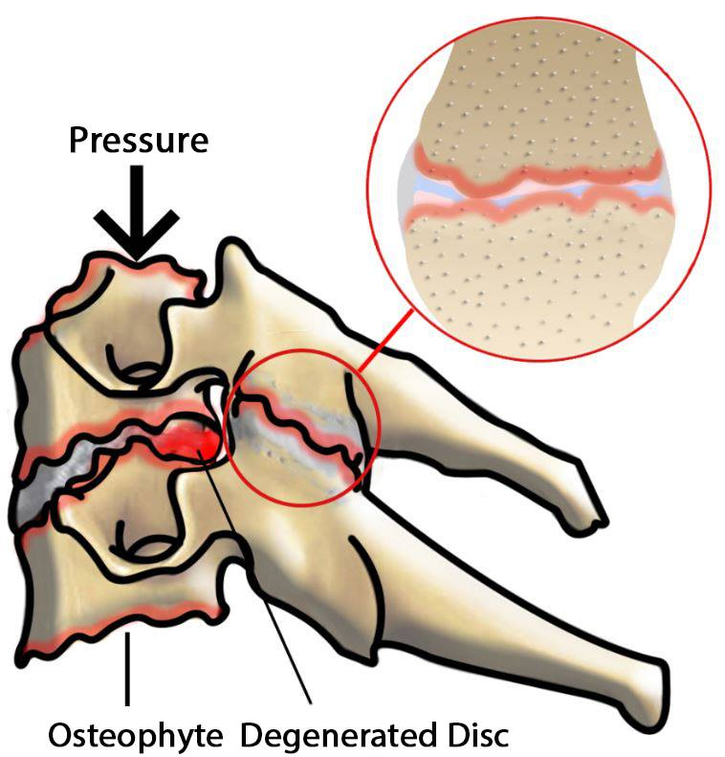
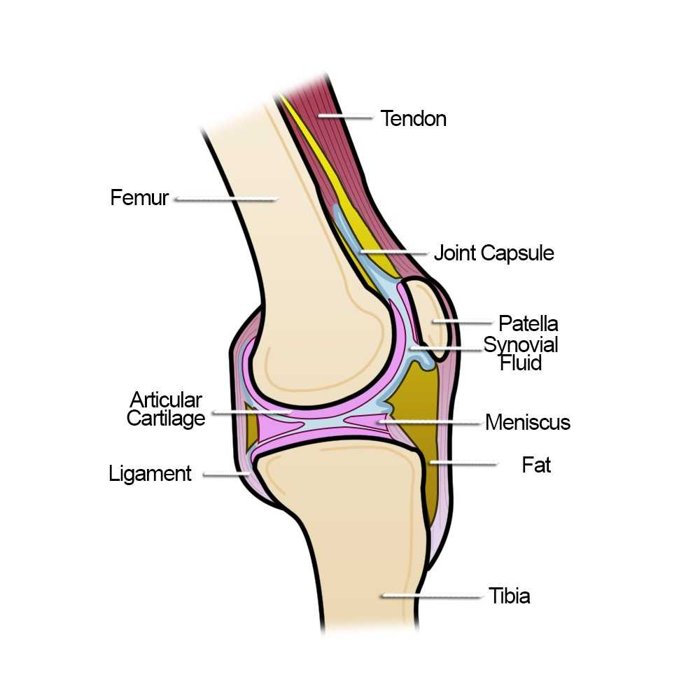
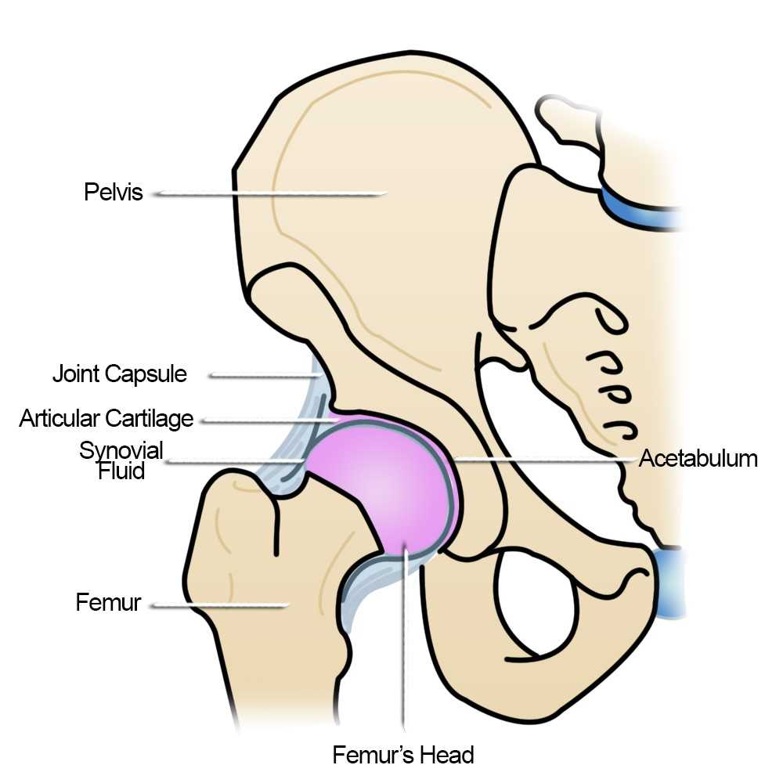
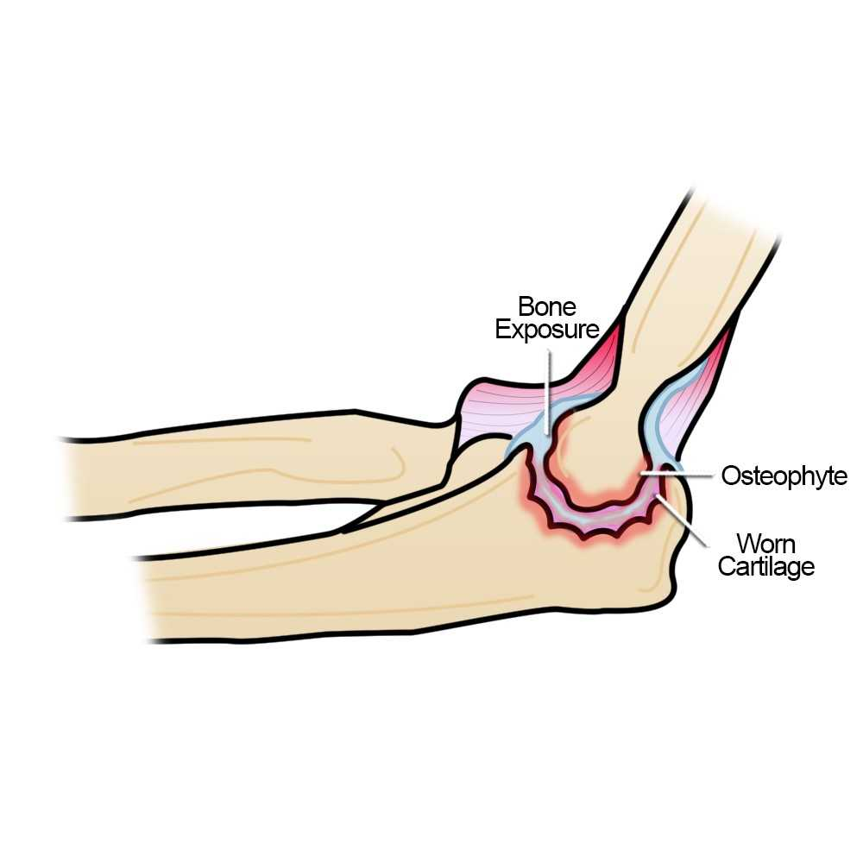
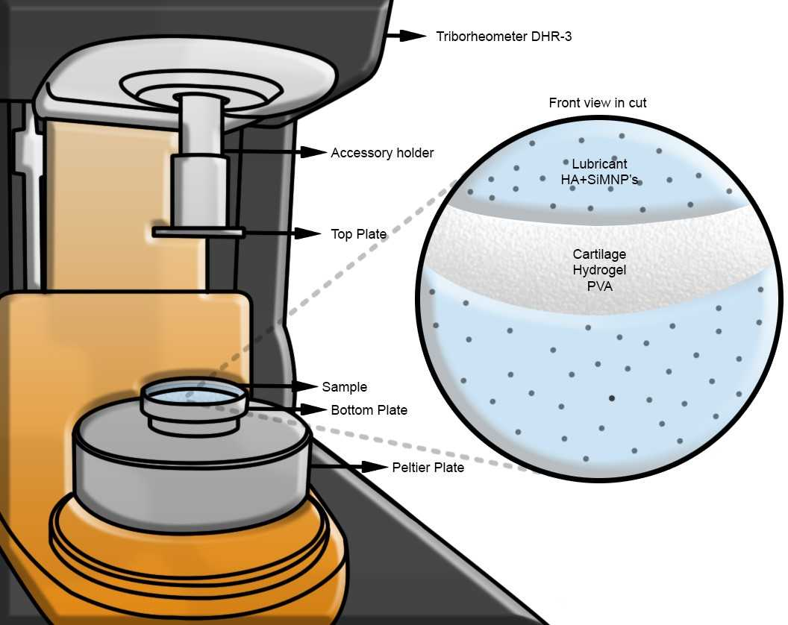
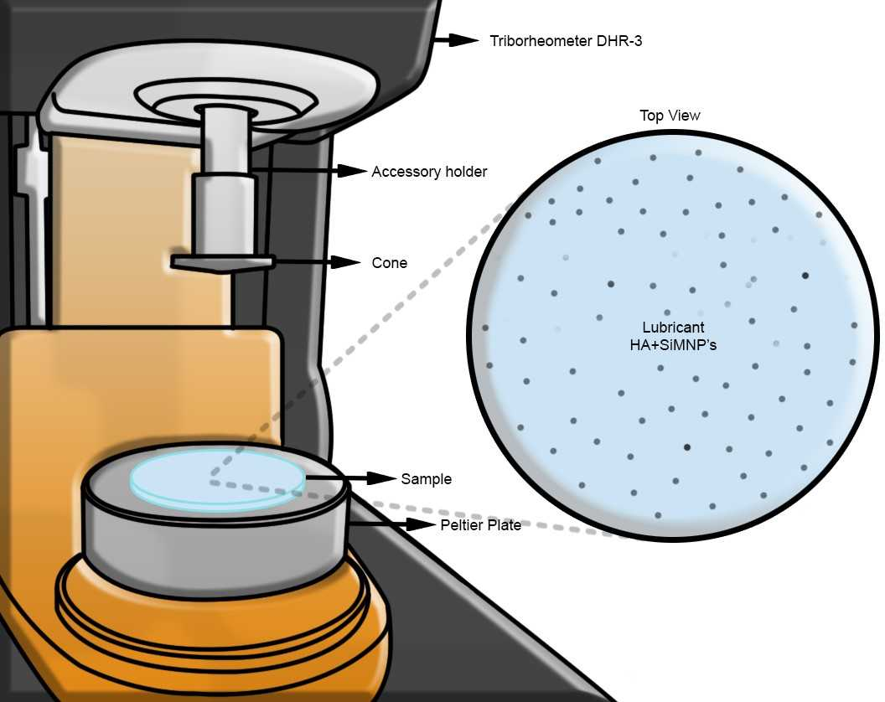
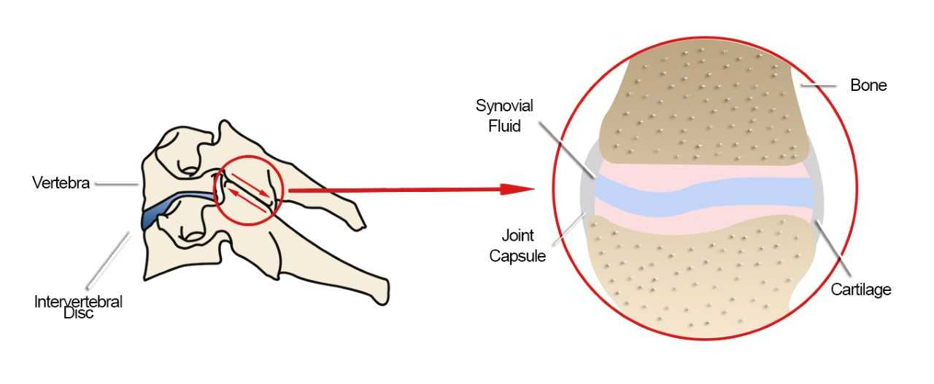
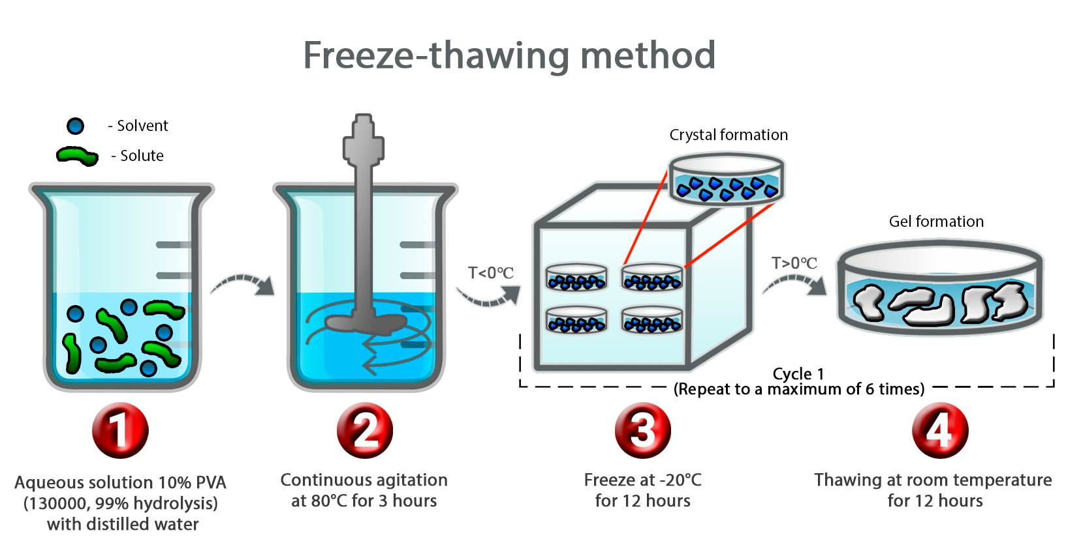
INTRODUCCTION
Thesis Description
Mechanical system
Synovial Joints of the human body
Osteoarthritis (OA)
Degenerative condition of synovial joints
Cartilage Replacement
Polymeric hydrogels (polyvinyl alcohol - PVA)
Lubricants
Fluids with additives (Hyaluronic acid - HA with mesoporous silica nanoparticles – SiMNP’s)
Importance of characterization techniques
Porosity, surface distribution, wear tracks and performance.

Slide 4
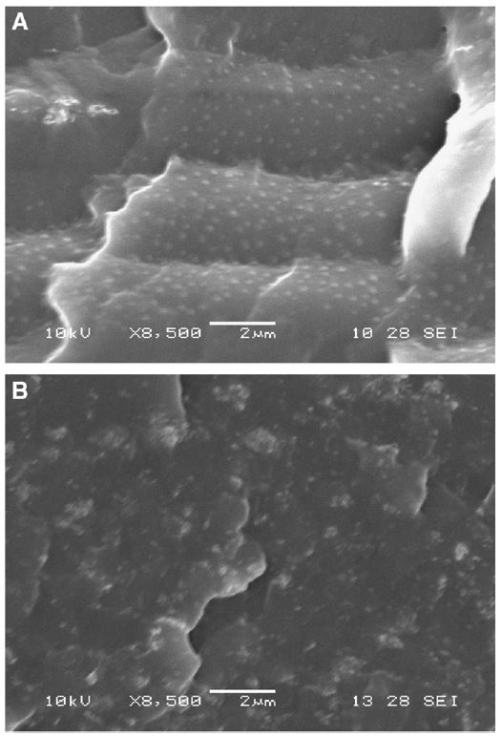
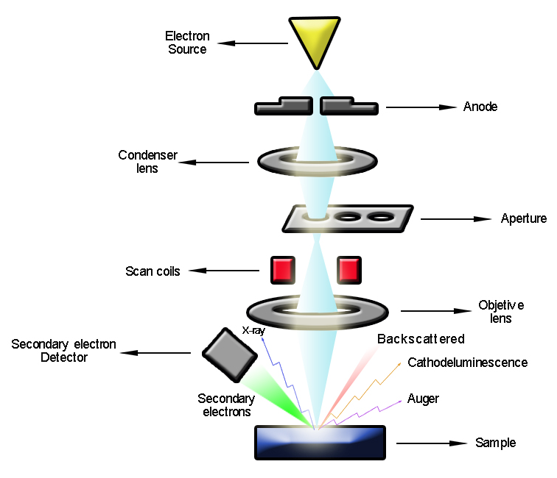
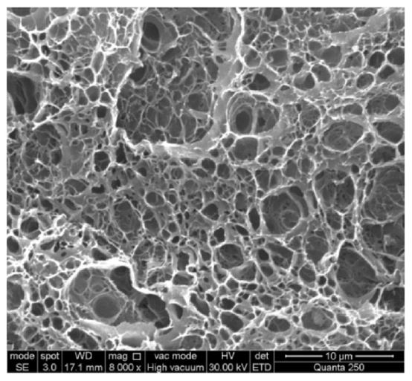
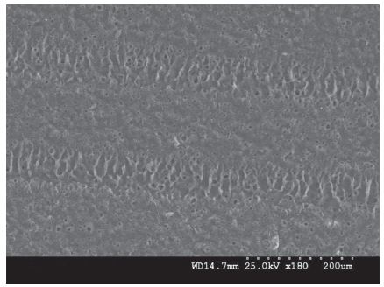
Scanning electron microscopy (SEM)
General description
A beam of electrons scans across the material surface, producing high-energy back-scattered electrons, low-energy secondary , auger electrons and cathodeluminescence. The back-scattered electrons provides a physical image of the surface whit their analysis
Sample preparation
Dry sample with conductivity properties. Coating with a tiny film of gold
1
Porosity
2
Surface distribution
3
Wear tracks after triborheological tests
4
Nanoparticles distribution in the lubricant
Chen et al., "Preparation and property of high strength and low friction PVA-HA/PAA composite hydrogel using annealing treatment “, Materials Science and Engineering C, vol. 91, pp. 579 – 588, 2018.
Li et al., "The Effects of Surface Mechanical Deformation and Bovine Serum Albumin on the Tribological Properties of Polyvinyl Alcohol Hydrogel as an Artificial Cartilage “, Advances in Materials Science and Engineering, pp. 1 – 10, 2017.
Maiolo et al., "Development and characterization of Poly (vinyl alcohol) based hydrogels for potential use as an articular cartilage replacement“, Materials Science and Engineering C, vol. 32, pp. 1490 – 1495, 2012.

Slide 5
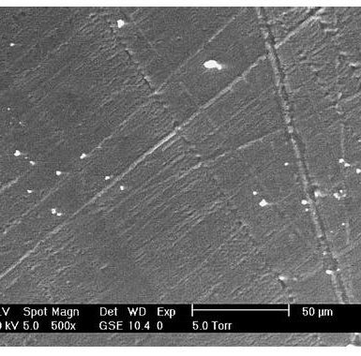
SEM derivation
Environmental scanning electron microscopy (ESEM)
Wet-mode
Maintain the natural hydrated state of the sample without additional preparation
Uses
Pores, wear and cracks
Li et al., "Influence of dynamic load on friction behavior of human articular cartilage, stainless steel and polyvinyl alcohol hydrogel as artificial cartilage“, J Mater Sci: Mater Med, vol. 21, pp. 147 – 154, 2010.

Slide 6
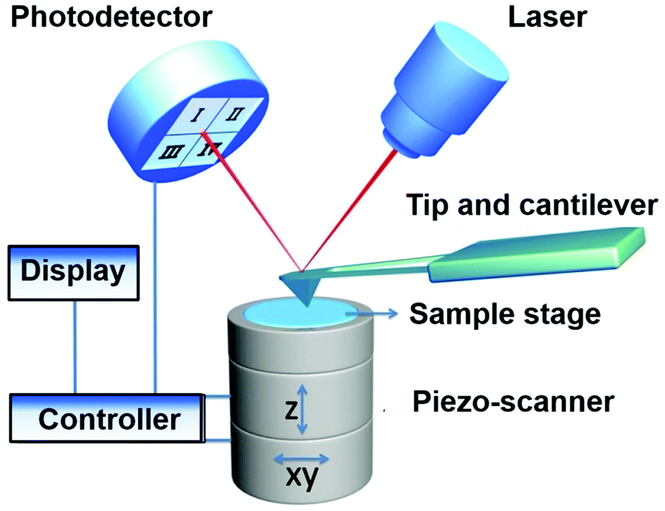
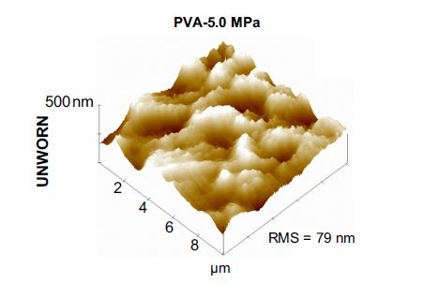
Atomic force
Microscopy (AFM)
A laser beam is reflected from a cantilever that has a tip (probe). As the tip approaches the sample, the cantilever experiments deflection towards or away from the surface, causing changes on the reflection of the detected beam. The changes are detected by a photo-diodo while a piezo scanner moves the tip over the sample.
*
Sample preparation : Hydrated state, tapping mode, distilled water, 37°C.
Sardinha et al., “Tribological characterization of polyvinyl alcohol hydrogel as substitute of articular cartilage”, Wear, vol. 301, pp. 218 – 225, 2013.
*
Use : Visualization of nano-roughness after test.
Shang, Yuping and Wang, Hongda, “The structure and function of cell membranes examined by atomic force microscopy and single-molecule force spectroscopy”, Chemical society reviews, vol. 44, pp. 3617 – 3638, 2015.

Slide 7
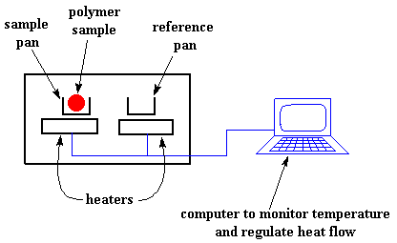
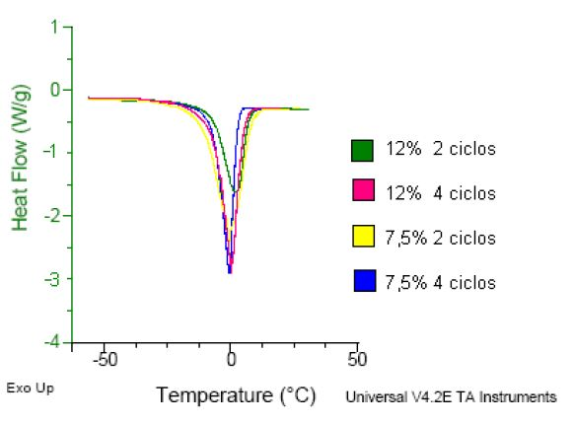
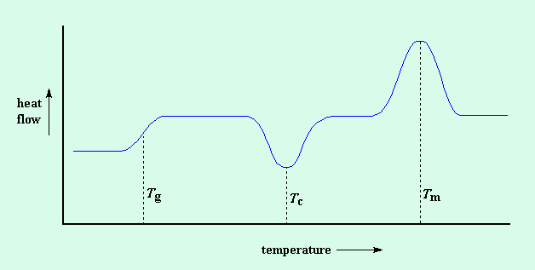
Differential scanning calorimetry (DSC)
Measurements of thermodynamic properties (heat capacity) of thermally induced transitions, applied to a variety of biological elements such as biopolymers. During experiments, parameters like post scan temperature, the number of scans, their range, scan rate, and feedback strength are important and can be changed to obtain the best results.
Sample preparation
Distilled water, low scan rate (10°C/min), nitrogen atmosphere, 40 – 250 °C
Uses
01
Change in water content (hydrophilic behavior)
Echeverri et al., “Síntesis y caracterización de hidrogeles de alcohol polivinilíco por la técnica de congelamiento/descongelamiento para aplicaciones Médicas”, Revista EIA, vol. 12, pp. 59 – 66, 2009.
02
Simple Portfolio Presentation
Peak temperature values (Support at body temperature)
Polymer science learning center, “Differential scanning calorimetry”, 2019.

Slide 8
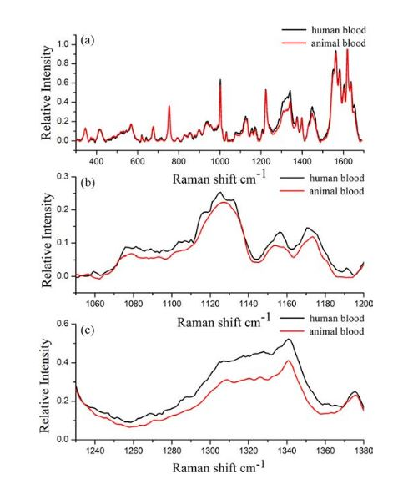
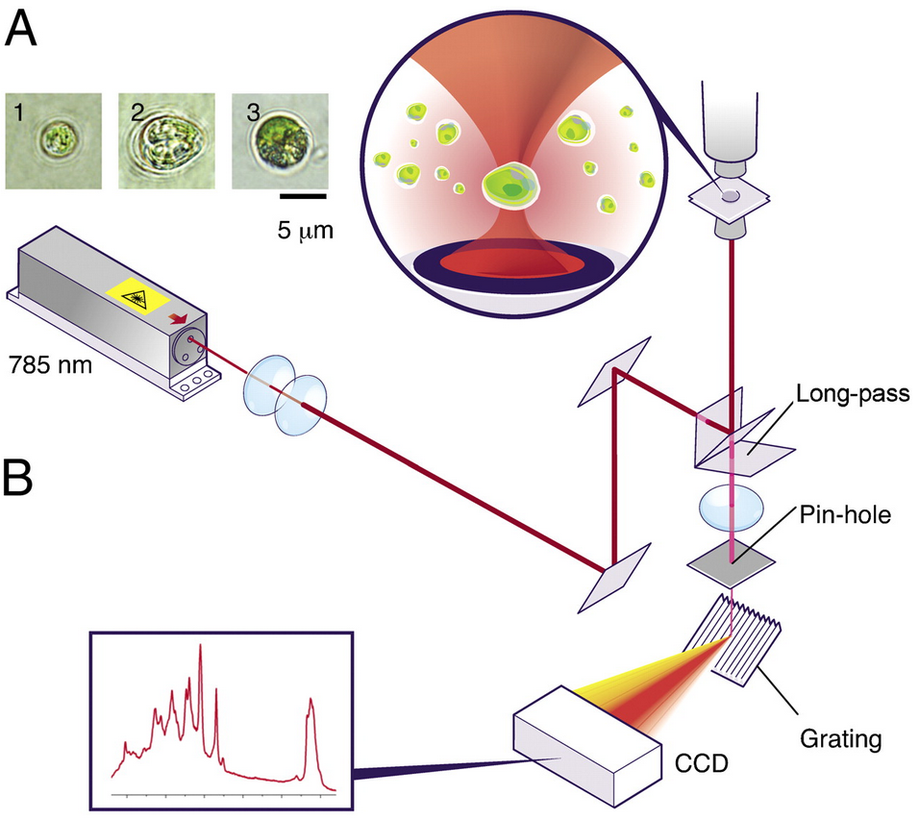
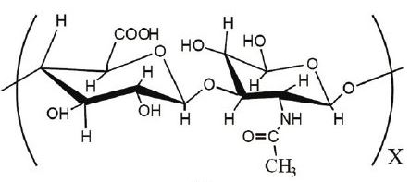
Recompile knowledge about molecular information (functional groups) and crystalline structures. A laser irradiate the sample with monochromatic radiation, with excitations in the UV, visible and near-IR spectral region (785-1064nm). The irradiation generates a Raman scattered light (spectrum) that is detected with a camera.
Raman spectroscopy
Sample preparation
Use
Work with metal slide at a excitation of 785 nm
See variations in the fluid structure after the addition of nanoparticles.
Wu et al., “In vivo lipidomics using single-cell Raman spectroscopy”, PNAS, vol. 108, pp. 3809 – 3814, 2011.
Kim et al., “Effect of pH on Swelling Property of Hyaluronic Acid Hydrogels for Smart Drug Delivery Systems”, Journal of Sensor Science and Technology, vol. 21, pp. 256 – 262, 2012.
Baia et al., “Discrimination of Human and Nonhuman Blood by Raman Spectroscopy and Partial Least Squares Discriminant Analysis”, Analytical letters, vol. 50, pp. 379 – 388, 2017.

Slide 9
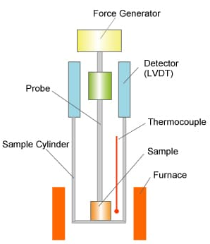
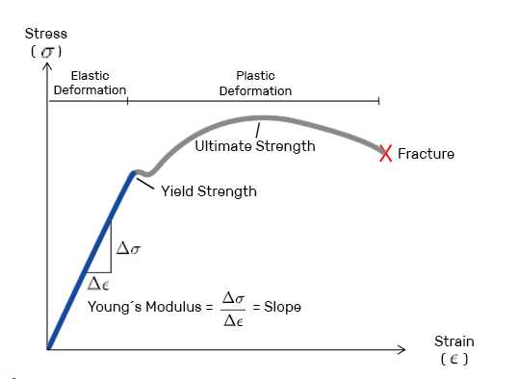
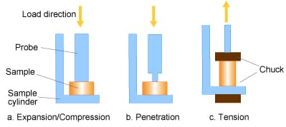
Thermomechanical analysis (TMA)
Changes in a dimension of a sample as a function of temperature, time, force and atmosphere . Force can be applied in compression, tension, flexure or torsion modes using different probes (quartz glass, silica, alumina and metals)
Sample preparation
Smooth, less of 10mm of height, silica probe, heating rate of 5k/min, nitrogen atmosphere, ramped force
Use
Mechanical properties of the hydrogel at body conditions (Elastic modulus – 0.45 a 0.8MPa)
Hitachi, “Principle of Thermomechanical Analysis (TMA)”, 2019

Slide 10
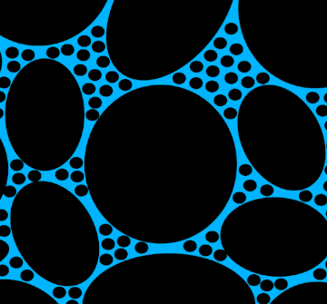
The Summary
Morphology
Characterization techniques in medical applications
Challenges of joint replacement processes
Study of synthetic articular cartilage and lubricant with nano-additives
Wear, composition, porosity and performance
Mechanical properties that gide the applications
Application
Elemental
Composition
1
2
Properties

Slide 11
F
I
N
A
L
P
r
o
j
e
c
t
Characterization of materials
Thank You
Q/A

